Slide 1
Apply TX Guide
SAC High School Programs

Slide 2
Apply Texas
Create an account on the Apply Texas application website: https://goapplytexas.org
Click on “Get Started” to begin.
Your company name

Slide 3
Apply Texas
Create a username use your email if possible
Enter preferred email address
We recommend that you use a personal email address on your Apply Texas account as some school districts have security settings that will not allow students to receive emails from senders outside the district.
The email address you enter on your profile will become your Apply Texas account username. It will also be used by Apply Texas and colleges and universities to communicate with you.
Create a password
Needs one upper case, a special character, and at least 12 characters long
Your company name

Slide 4
Profile
Select checkbox to agree to the Privacy Policy and enter in your personal information.
Please take your time and enter in your information accurately.
Note Social Security isn’t required
Your company name

Slide 5
Profile
Be sure to enter you last name and first name in correct fields
Read 1st checkmark and if you have an alias please check
Read 2nd checkmark and if you need change email address if you have created an account already previously
Your company name

Slide 6
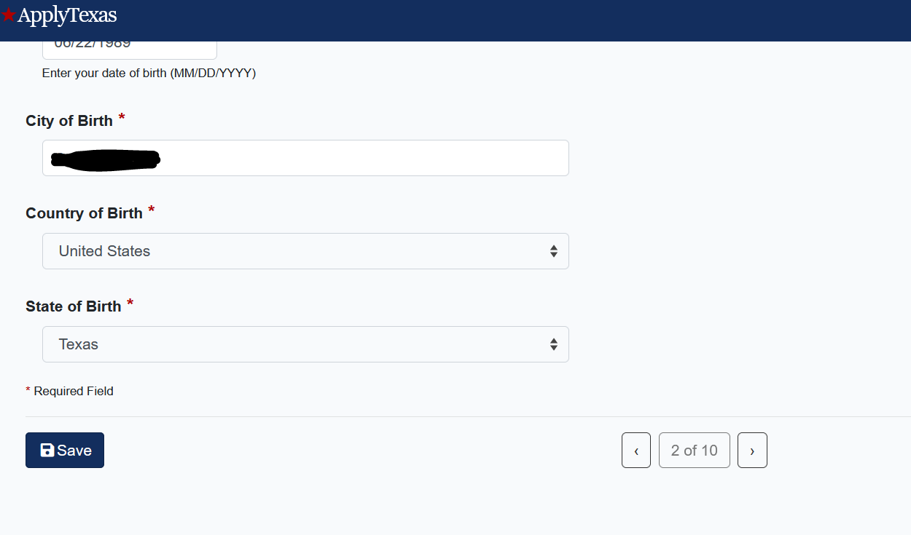
Profile
Enter your city of birth.
Select your country of birth
Select a State/Possession/Province only if you were born in the U.S. or Canada.
Your company name

Slide 7
Profile
If you are a U.S. Citizen, answer “yes” and continue to the next question.
If you are not a U.S. citizen, additional questions will appear so that you can tell us more about your citizenship and residency.
Complete this section before you advance to the next question.
Enter your gender
Your company name

Slide 8
Profile
If you are not a U.S. citizen questions will appear so that you can tell us more about your citizenship and residency.
Select Country & answer if you hold residence status
Do you have application for permanent residence
Select if you have or will be living in Texas 36 months leading up to your graduation
Complete this section before you advance to the next question.
Your company name

Slide 9
Profile
If you are a U.S. Citizen, answer “yes” and continue to the next question.
Answer if you are a dependent of military
Answer the questions about Ethnicity and Race and Your Gender using the race and gender that you identify yourself as.
Complete this section before you advance to the next question.
Your company name

Slide 10
Profile
A permanent address is required for setting up an Apply Texas account and it is important that it be complete and correct, including an apartment number if applicable.
The State/Possession/Province field is used only for U.S. and Canadian addresses.

Slide 11
Profile
A permanent address is required for setting up an Apply Texas account and it is important that it be complete and correct, including an apartment number if applicable.
The State/Possession/Province field is used only for U.S. and Canadian addresses.
Click verify address

Slide 12
Profile
A physical address is needed only if it is different than your permanent address.

Slide 13
Profile
Enter your phone number
Enter phone type
Your company name

Slide 14
Profile
Enter your emergency contact information
Name, phone, email address, and address
Your company name

Slide 15
Profile
Type in the search field the name of your high school in the School Name field (leave all other fields blank)
Search Results will display high schools that match the school name you entered.
Select the high school with the correct name, address, and city.
Your company name

Slide 16
Profile
Enter expected graduation date-
May or June and then the year
Select No for question regarding GED
Your company name

Slide 17
Profile
Answer if you have previous college courses
Your option to be contacted by the THECB- yes or no
Answer no if you are not on academic suspension from a previous college
Your company name

Slide 18
Profile-Residency
Enter responses regarding residency as best you can
If you answer no to not living in Texas 36 months prior to graduation, more questions will populate. If yes you will see other questions
For question number 4 you can answer yes if you currently reside in San Antonio
For question 5 the answer is no unless you have other prior college credits
Your company name

Slide 19
Profile-Residency
For question 3 -if you answered no to not living in Texas 36 months prior to graduation, more questions will populate. If yes you will see other questions
Answer if you are a claimed as a dependent
Is your parent US Citizen
If not do they have a permanent resident of US
Is your parent a foreign national with application being reviewed
Select which type of visa if applicable
Your company name

Slide 20
Profile-Residency
Does parent live in Texas?
How many years have they been living here
How many months have they been living here
What is your parent’s main purpose for being in the state
Is your parent a member of the US Military
What is the state your parent lists for tax purposes
Your company name

Slide 21
Profile-Residency
Does parent hold tile to property
Does parent have ownership interest in a business
Has your parent been gainfully employed past 12 months
Has your parent received support from social services agency
Is your parent married to a person who owns property, business, or support from social services
Your company name

Slide 22
Profile Complete
You will receive an automated e-mail from Apply Texas titled “Verify your email address for goapplytexas.org”
This e-mail will be sent to the email address you enter on your profile. This email is NOT verification that the application has been completed or submitted.

Slide 23
New Application
Click on the Start/Edit Applications and the Start a New Blank Application link.

Slide 24
New Application
Click on the Start/Edit Applications and the Start a New Blank Application link.
Select two year community/junior college

Slide 25
New Application
Select the institution to apply for the pull down menu organizes institutions alphabetically
San Antonio College (San Antonio)
Then select again the application type
Two Year

Slide 26
New Application
Select your semester
Fall 2022
Traditional Dual Credit Students: Select first choice school-Creative Communication Arts and first choice major-Dual Credit
If you belong to an ECHS or PTECH High School see table below
HIGH SCHOOL | 1st CHOICE SCHOOL | MAJOR
HTECH at Fox Tech | Health and Biosciences | Biology/Pre-Nursing-Pre-Major
Edison PTECH School of Business | Business and Entrepreneurship | Accounting Technology, AAS Business Administration -PreMajor
Travis ECHS & Brooks Collegiate Academy ECHS | Creative and Communication Arts | Liberal Arts-Pre-Major
Southwest Legacy & Southwest HS | Science and Technology | Information Assurance and Cybersecurity, AAS

Slide 27
NEW APPLICATION
You will now see below in your login page the pending items needed to complete the application
Two year questions
Questions specific to SAC
Click the first one Two Year questions

Slide 28
New Application
Foster care- yes or no
Homeschooled- yes or no
Tech Prep course- no

Slide 29
New Application
Select Dual Credit for basis of admissions
Select Earn credit for transfer; if you are part of ECHS or PTECH High School Select Earn Associate Degree

Slide 30
NEW APPLICATION
Click the forward arrow for the next two sections
Extracurricular
Community/Volunteer Service
Last page in this section is also blank for Talents/ Awards click done to complete this section of application

Slide 31
New Application
Select the second item listed: Questions specific to San Antonio College
Select no for online courses only
Select no for Early College High School
Answer if you are a HS Senior- yes or no

Slide 32
New Application
Select No for the following two questions

Slide 33
NEW APPLICATION
You will now see below in your login page the two sections completed with checkmarks
Two year questions
Questions specific to SAC
Click on Submit this application

Slide 34
Submit Application
Select the checkbox to certify you have read and understood the above

Slide 35
Submit Application
Select the checkbox to certify you have read and understood the regarding Bacterial Meningitis
Select the checkbox to certify you have read and understood the policies and rules
Select no if don’t consent to THECB to contact you

Slide 36
Submit Application
Click Submit to complete your application!

Slide 37
Congratulations on submitting your application to San Antonio College!
Your next steps:
Wait 3-5 days for your application to process
Complete Go FAARR and Test Prep Modules in ACES
Take the TSI exam OR request your official SAT/ACT scores

Slide 38
Contact High School Programs:
210-486-0177
sac-hsp@alamo.edu

